Slide 1
FISH270
Lecture 8

Slide 2
Osmoregulation

Slide 3
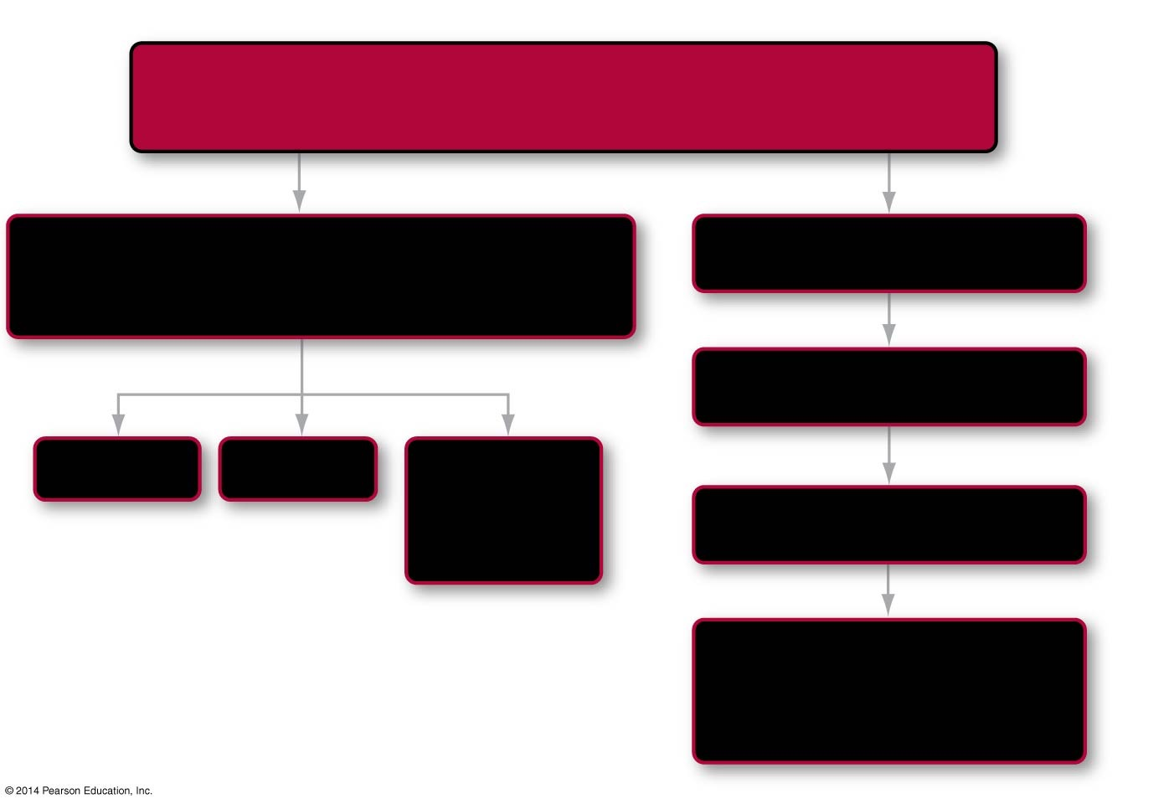
Roadmap 43
In this chapter you will learn that
Different habitats pose different challenges with regard to maintaining water and electrolyte balance
asking
looking closer at
How do animals control the concentration of water and salt in their bodies?
Marine fishes
43.2
43.1
comparing to
by reviewing
Freshwater fishes
43.3
Diffusion
Osmosis
Transport across membranes
comparing to
Terrestrial insects
43.4
and to
Terrestrial vertebrates— the mammalian kidney
43.5
Notes:
Chapter 43 Opening Roadmap.

Slide 4

Roadmap 43
In this chapter you will learn that
Different habitats pose different challenges with regard to maintaining water and electrolyte balance
asking
looking closer at
How do animals control the concentration of water and salt in their bodies?
Marine fishes
43.2
43.1
comparing to
by reviewing
Freshwater fishes
43.3
Diffusion
Osmosis
Transport across membranes
comparing to
Terrestrial insects
43.4
and to
Terrestrial vertebrates— the mammalian kidney
43.5
Notes:
Chapter 43 Opening Roadmap.

Slide 5
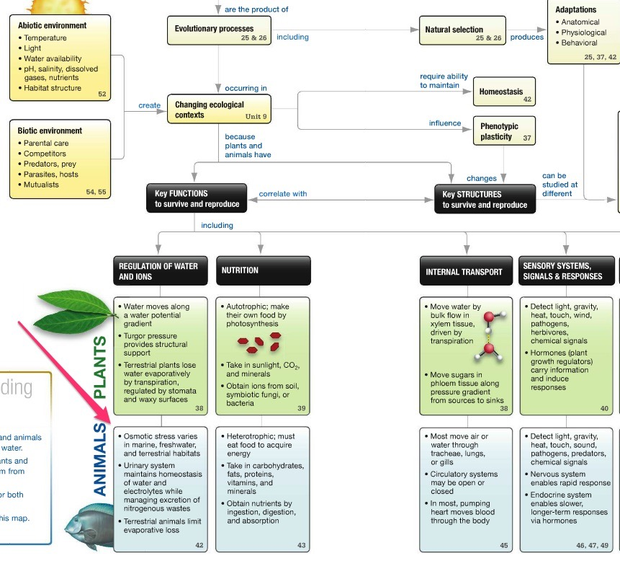

Slide 6
Introduction
The chemical reactions that make life possible occur in an aqueous solution
If the balance of water and solutes in the solution is disturbed, those chemical reactions—and life itself—may stop
An electrolyte is a compound that dissociates into ions when dissolved in water
Because cells require precise concentrations of Na⁺, Cl–, K⁺, and Ca²⁺ to function normally, maintaining electrolyte balance is crucial

Slide 7
Introduction
The chemical reactions that make life possible occur in an aqueous solution
If the balance of water and solutes in the solution is disturbed, those chemical reactions—and life itself—may stop
An electrolyte is a compound that dissociates into ions when dissolved in water
Because cells require precise concentrations of Na⁺, Cl–, K⁺, and Ca²⁺ to function normally, maintaining electrolyte balance is crucial
Why?

Slide 8
Introduction
Animals must maintain water and electrolyte balance in three environments:
Freshwater
Marine
Terrestrial

Slide 9
Osmoregulation and Excretion
Electrolytes and water move through organisms by diffusion and osmosis
Diffusion is the movement of substances from regions of higher concentration to regions of lower concentration, along their concentration gradients

Slide 10
Osmoregulation and Excretion
Electrolytes and water move through organisms by diffusion and osmosis
Diffusion is the movement of substances from regions of higher concentration to regions of lower concentration, along their concentration gradients
Osmosis is the diffusion of water through a selectively permeable membrane from areas of higher water concentration to areas of lower water concentration
The high to low concentration of substances or water is known as the concentration gradient

Slide 11
Osmoregulation and Solute Concentration
Dissolved substances, or solutes, move down their concentration gradients across a selectively permeable membrane via diffusion
Solution osmolarity—the concentration of dissolved substances in a solution, measured in moles per liter

Slide 12
Osmoregulation and Solute Concentration
Water can also move down the concentration gradient
Water interacts with the solutes
Increase in the solute concentration reduces the concentration of the water
Water will move to the area of higher concentration of solutes

Slide 13
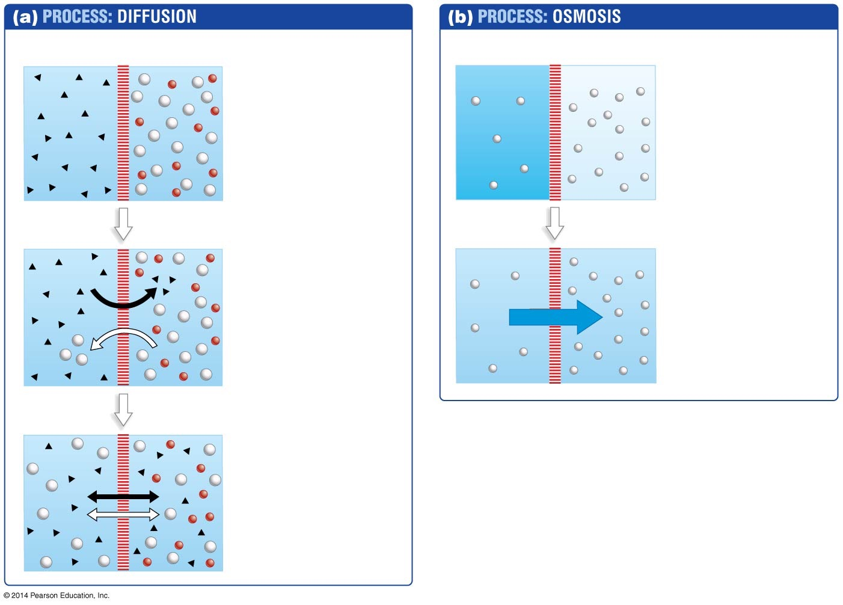
Figure 43.1
Selectively permeable membrane
Selectively permeable membrane
1. Start with different solutes on opposite sides of a selectively permeable membrane.
Low osmolarity
High osmolarity
1. Start with more solute on one side of a selectively permeable membrane.
2. Solute diffusion along concentration gradients.
2. Water diffusion toward region or higher solute concentration (higher osmolarity).
Diffusion
Osmosis
3. Equilibrium is established.
Notes:
Figure 43.1 Solutes Move Down a Concentration Gradient via Diffusion; Water Moves Down a Concentration Gradient via Osmosis.

Slide 14
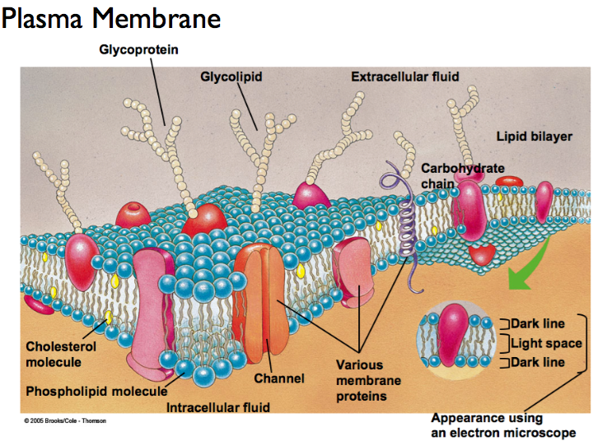

Slide 15
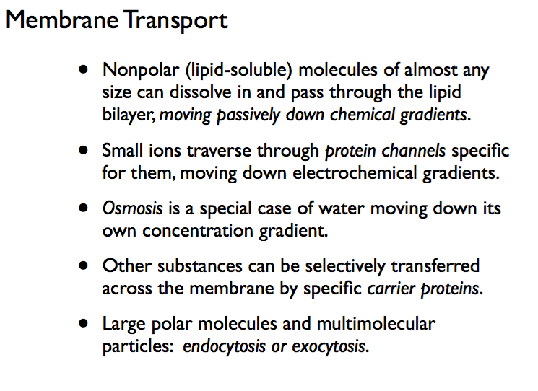

Slide 16
Figure 43.1
Selectively permeable membrane
Selectively permeable membrane
1. Start with different solutes on opposite sides of a selectively permeable membrane.
Low osmolarity
High osmolarity
1. Start with more solute on one side of a selectively permeable membrane.
2. Solute diffusion along concentration gradients.
2. Water diffusion toward region or higher solute concentration (higher osmolarity).
Diffusion
Osmosis
3. Equilibrium is established.
Notes:
Figure 43.1 Solutes Move Down a Concentration Gradient via Diffusion; Water Moves Down a Concentration Gradient via Osmosis.

Slide 17
What Is Osmotic Stress?
Osmotic stress occurs when the concentration of dissolved substances in a cell or tissue is abnormal
Osmoregulation is the control of water and solutes within cells

Slide 18
What Is Osmotic Stress?
Organisms such as sponges and jellyfish do not need to osmoregulate, because seawater is a fairly constant ionic and osmotic environment and nearly matches the electrolyte concentrations found within these animals
Relative to seawater, their tissues are isotonic—that is, the concentration of solutes is equal in and outside the cells
Such animals are called osmoconformers
Making seawater is isosmotic in comparison to the cells and tissues

Slide 19
Osmotic Stress in Seawater
In contrast to osmoconformers, most marine fish are osmoregulators. Fish actively regulate osmolarity inside their bodies to achieve homeostasis
Osmoregulation is required in marine vertebrates because their tissues are hypotonic to salt water—the solution inside the cells contains fewer solutes than the solution outside
So what, who cares?

Slide 20
Osmotic Stress in Seawater
In contrast to osmoconformers, most marine fish are osmoregulators. Fish actively regulate osmolarity inside their bodies to achieve homeostasis
Osmoregulation is required in marine vertebrates because their tissues are hypotonic to salt water—the solution inside the cells contains fewer solutes than the solution outside
They lose water by osmosis and gain electrolytes by diffusion
This can affect gas exchange, the function of the gills

Slide 21
Hyperosmotic Seawater and Gas Exchange
Because the seawater is hyperosmotic in solutes, causing the loss of water, marine fishes must replace the water or the cells will die and there will be a loss of gas exchange
Marine fishes must drink large amounts of water to replace the loss of water, which also brings more electrolytes
Thus marine fishes must regulate the electrolyte and water balance to obtain homeostasis
Membrane proteins are used to actively pump out the ions

Slide 22
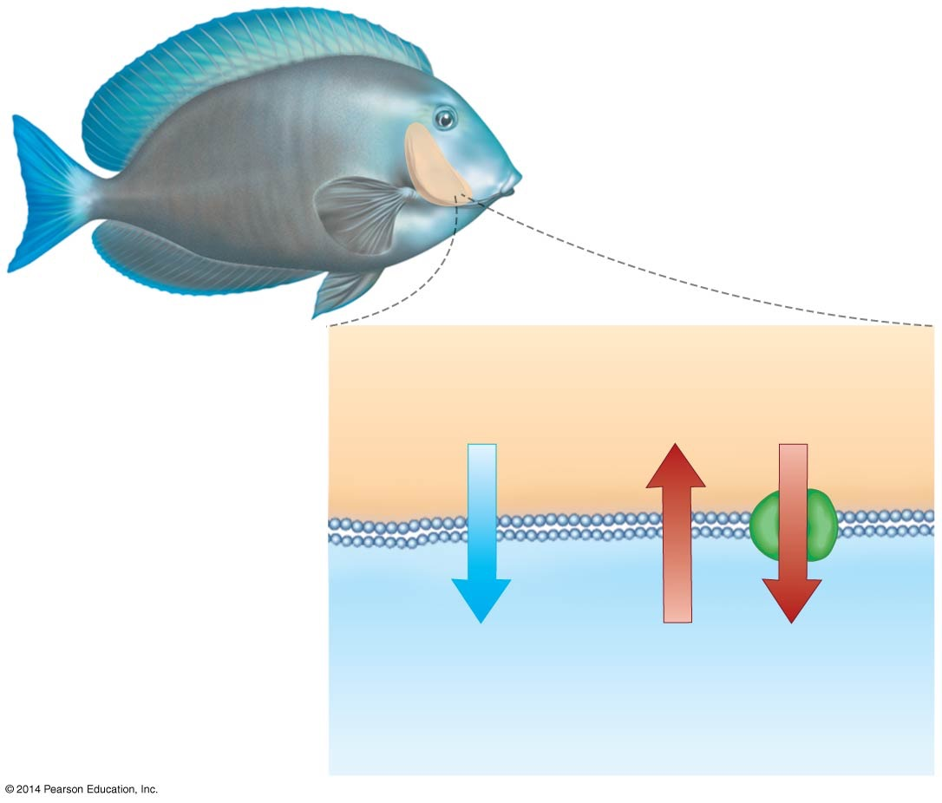
Figure 43.2
Gill
Gain many electrolytes by diffusion
Gill tissue (lower osmolarity)
Seawater (higher osmolarity)
Lose large amounts of water by osmosis
Lose electrolytes through active transport out
Notes:
Figure 43.2 Marine Fishes Lose Water by Osmosis and Gain Electrolytes by Diffusion.

Slide 23
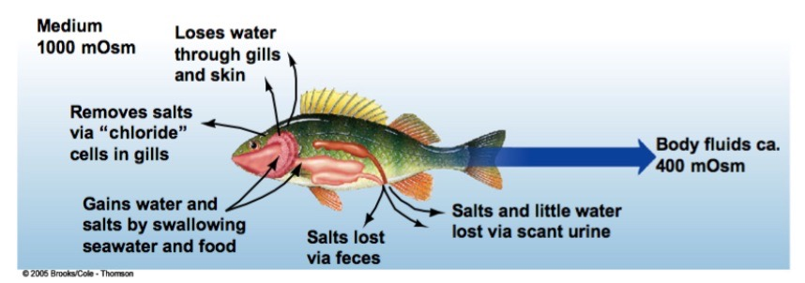

Slide 24
Osmotic Stress in Freshwater
Freshwater animals are under osmotic stress because they gain water and lose salt
The tissues of freshwater fish are hypertonic to the surrounding water
The solution inside the cells contains more solutes than the solution outside
Thus their cells gain water through osmosis and lose electrolytes by diffusion

Slide 25
Osmotic Stress in Freshwater
The electrolytes are replaced in two ways:
As nutrients from food sources
Active transport from the water

Slide 26
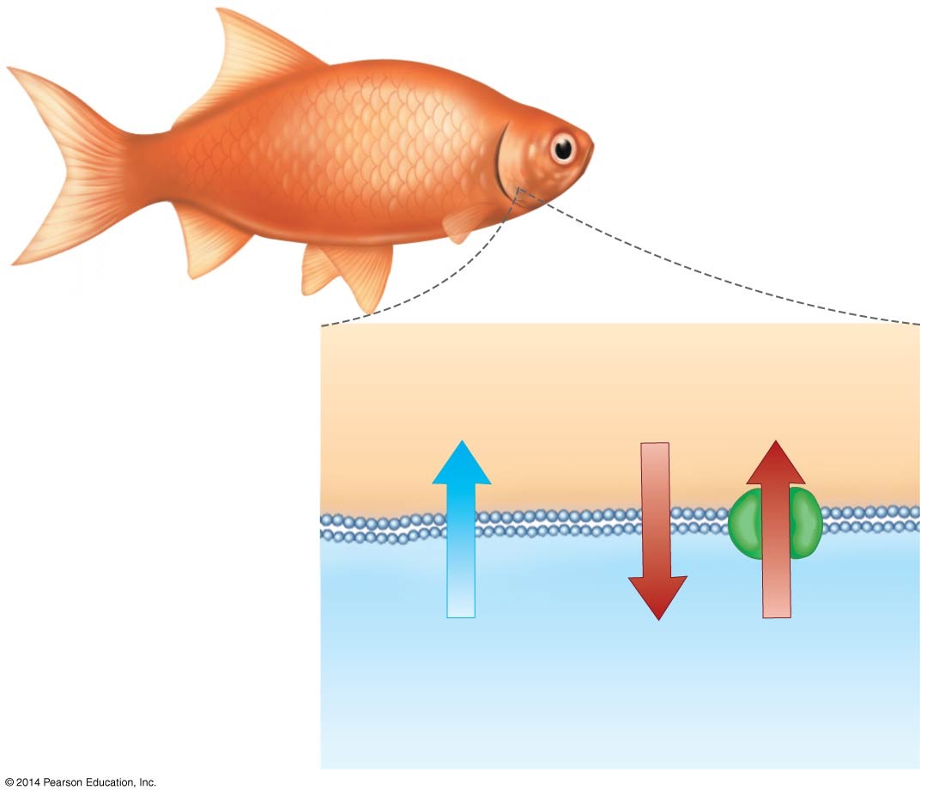
Figure 43.3
Gill
Gain water by osmosis
Gain electrolytes through active transport in
Gill tissue (higher osmolarity)
Freshwater (lower osmolarity)
Lose electrolytes by diffusion
Notes:
Figure 43.3 Freshwater Fishes Gain Water by Osmosis and Lose Electrolytes by Diffusion.

Slide 27
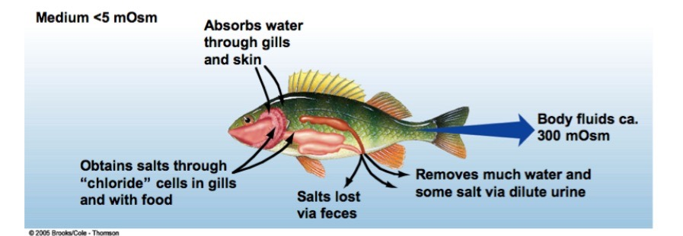

Slide 28
Osmotic Stress on Land
Land animals constantly lose water to the environment, just as many marine animals do, but they lose it by evaporation rather than osmosis
Land animals also lose water when they produce urine and when they sweat or pant
The loss of water is replaced by drinking, by ingesting water from food, or by metabolic pathways

Slide 29
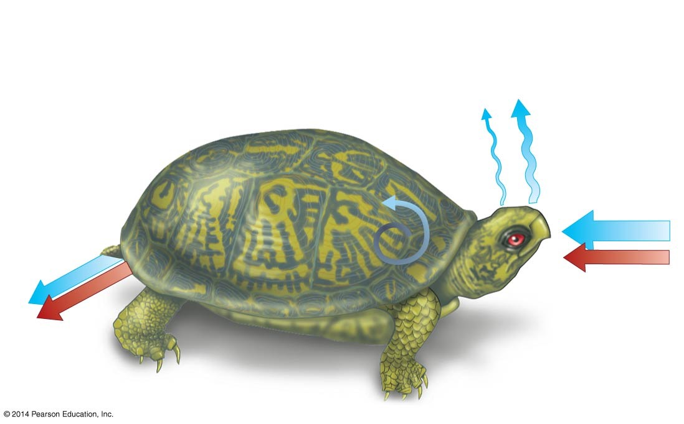

Figure 43.4
Lose water from other parts of body to evaporation
Lose water from lungs during breathing
Water
Electrolytes
Replace water by drinking and eating
Lose water in urine and feces
Gain metabolic water
Gain electrolytes in food
Lose electrolytes in urine
Notes:
Figure 43.4 Maintaining Water and Electrolyte Balance in Terrestrial Environments Is Particularly Challenging.

Slide 30
How Do Electrolytes and Water Move Across Cells?
Solutes move across membranes by passive or active transport
Passive transport is driven by diffusion along an electrochemical gradient and does not require an expenditure of energy in the form of ATP
Facilitated diffusion is passive transport of solutes via proteins called channels or carriers

Slide 31
How Do Electrolytes and Water Move Across Cells?
Active transport occurs when ATP powers the movement of a solute against its electrochemical gradient
Based on membrane proteins called pumps

Slide 32
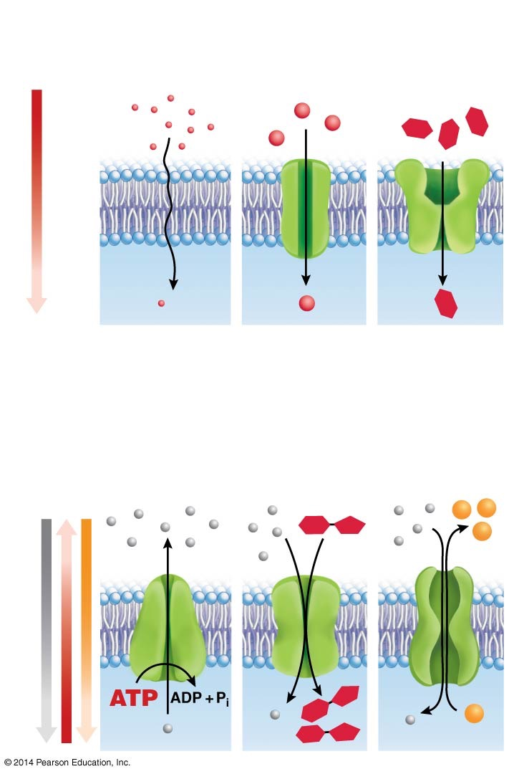
Figure 43.5
(a) Passive transport is based on diffusion down a gradient.
Facilitated diffusion
Direct diffusion
Channel
Carrier
Outside cell
Electrochemical gradient
Lipid bilayer
Inside cell
Membrane proteins
(b) Active transport requires an energy source to move molecules against a gradient.
Secondary active transport (cotransport; driven by energy from gradient)
Primary active transport (driven by energy from ATP)
Pump
Symporter
Antiporter
Electrochemical gradient
Notes:
Figure 43.5 Mechanisms of Passive and Active Transport.

Slide 33
Active Transport Uses Pumps
The sodium–potassium pump (Na⁺/K⁺-ATPase) is the most important type of pump in animals
ATP is used to move ions against the concentration gradient
Once a pump establishes a concentration gradient, secondary active transport can occur

Slide 34
Active Transport Uses Pumps
The energy released when a solute is transported along its concentration gradient can be used by a cotransporter to transport another molecule against its concentration gradient
Two types of cotransporters
Symporters move solutes in the same direction
Antiporters move solutes in opposite directions

Slide 35
How Water Is Moved
Cells use pumps to move the ions in or out
Water has no known mechanism for movement, but generally follows the ions via osmosis
Water balance is related to excretion because the removal of waste products and urine require that solutes be dissolved in water

Slide 36
Nitrogenous Wastes and Osmotic Stress
Minimizing water loss, excretion of wastes, and blood composition are all related to maintaining homeostasis and avoiding osmotic stress
Types of nitrogenous wastes:
Ammonia (NH₃) is a by-product of catabolic reactions
Ammonia is a strong base; it readily gains a proton to form an ammonium ion (NH₄⁺). This ion is eventually toxic to cells
Different species get rid of ammonia safely and efficiently in different ways

Slide 37
Forms of Nitrogenous Waste Vary among Species
Fish detoxify ammonia by diluting it to a low concentration and excrete it as watery urine
In freshwater and saltwater fish, ammonia diffuses across the gills into the surrounding water along a concentration gradient
Humans convert ammonia to less toxic urea and excrete it in urine
Birds, reptiles, and terrestrial arthropods convert ammonia to uric acid, which can be excreted as a dry paste

Slide 38
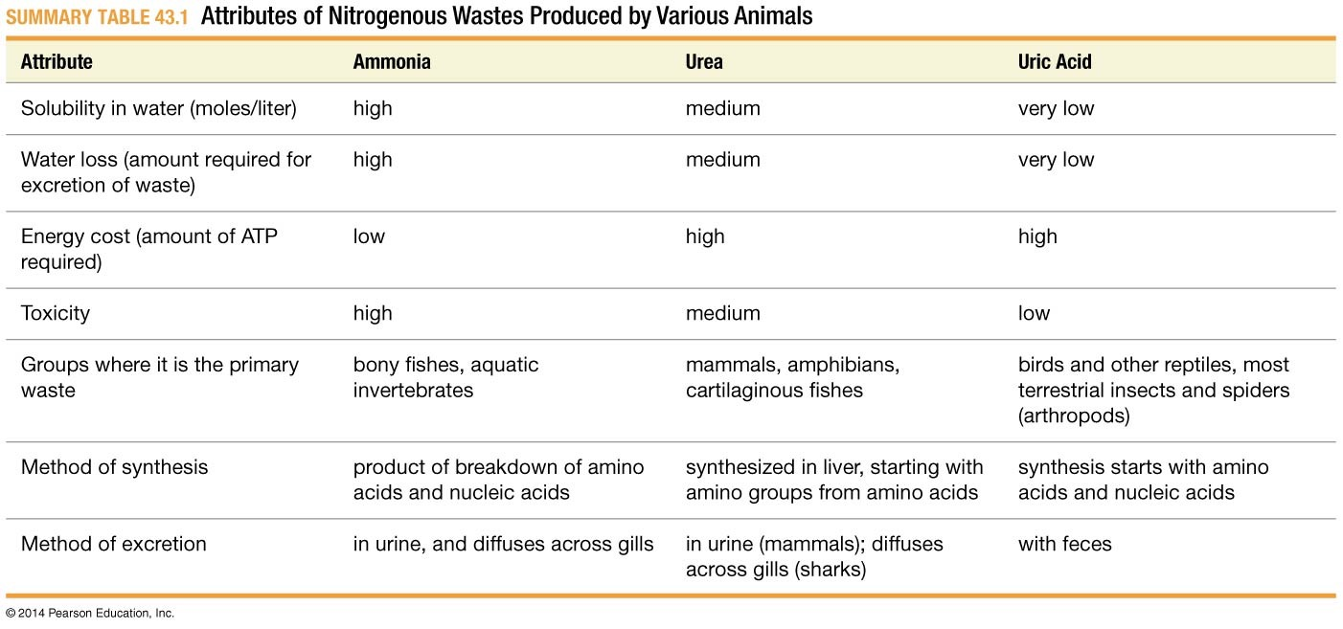
Table 43.1
Notes:
SUMMARY TABLE 43.1 Attributes of Nitrogenous Wastes Produced by Various Animals

Slide 39
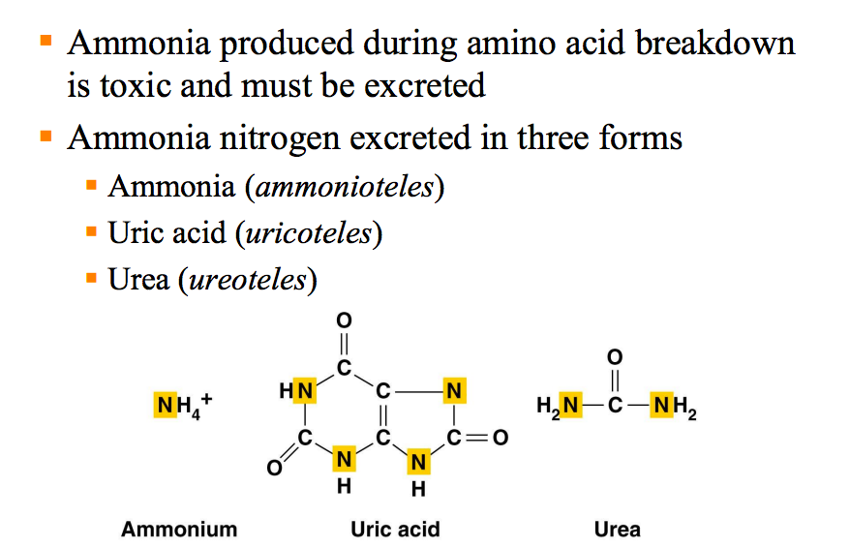

Slide 40
Osmoconformation versus Osmoregulation
Osmoregulators
Maintain balance by taking in water and transport electrolytes out
Marine bony fishes are osmoregulators
Osmoconformers
Maintain high urea content, which increases electrolytes and makes their blood isotonic with seawater
Why?

Slide 41
Osmoconformation versus Osmoregulation
Osmoregulators
Maintain balance by taking in water and transport electrolytes out
Marine bony fishes are osmoregulators
Osmoconformers
Maintain high urea content, which increases electrolytes and makes their blood isotonic with seawater
Water loss is less
Cartilaginous fishes are osmoconformers

Slide 42
Sharks as Osmoconformers
Sharks avoid water loss by osmoconforming
Sharks have a high salt content and must secrete salt through a system that is very similar to the system in Homo sapiens
Ions can be concentrated only if they are actively transported against a concentration gradient
Active transport is used to set up the electrochemical gradient found in animal and plant cells
Typically the sodium ion in animal cells
Typically the H⁺ ion in plant cells

Slide 43
How Do Sharks Secrete Salt?
The shark rectal gland secretes a concentrated salt solution
Epithelial cells along the inner surface, or lumen, of the shark rectal gland contain sodium–potassium pumps
This supports the idea that salt excretion is an active transport system
Rectal glands that are treated with ouabain stop producing a concentrated salt solution
This was strong evidence that Na⁺/K⁺-ATPase is essential for salt excretion

Slide 44
How Do Sharks Secrete Salt?
Ouabain is a plant defense compound that is toxic to animals because it prevents Na⁺/K⁺-ATPase from functioning

Slide 45
The Role of Na⁺/K⁺-ATPase
Salt excretion is a multistep process
Na⁺/K⁺-ATPase creates an electrochemical gradient favoring the diffusion of Na⁺ into the cell, allowing the cell transport other ions without additional energy expenditure
Na⁺, Cl–, and K⁺ enter the cell, powered by the Na⁺ gradient
Chloride channels allow Cl– to diffuse down its concentration gradient into the lumen of the gland
Na⁺ diffuses into the lumen of the gland, following the charge and concentration gradient of its ions

Slide 46
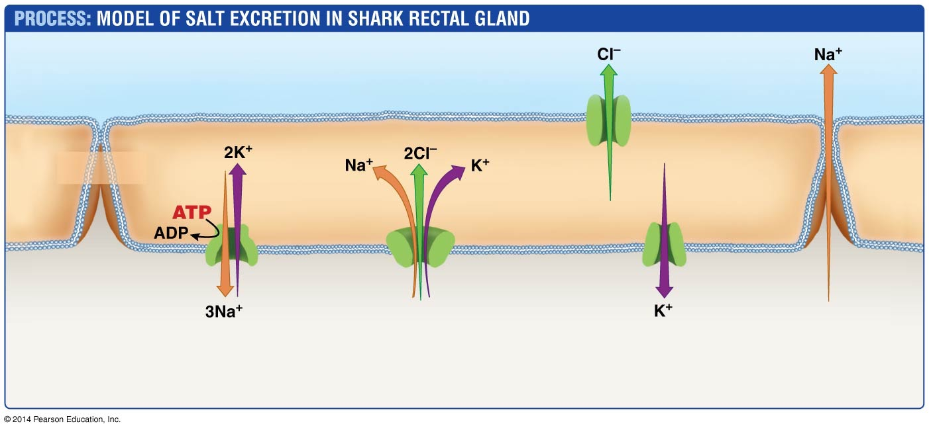
Figure 43.6
Lumen side (interior of gland empties into environment)
Chloride channel
Apical membrane
Epithelial cells of rectal gland
Basolateral membrane
Na⁺/K⁺- ATPase
Na⁺/Cl⁻/K⁺- cotransporter
Potassium channel
Extracellular fluid, near blood vessels
1. Na⁺ pumped out of cells; K⁺ pumped in.
2. Na⁺, Cl–, K⁺ transported into cells.
3. CI⁻ diffuses into lumen; K⁺ diffuses to extracellular fluid.
4. Na⁺ diffuses into lumen.
Notes:
Figure 43.6 The Shark Rectal Gland Rids the Body of Excess Salt.

Slide 47
A Common Molecular Mechanism of Salt Excretion
In many animals epithelial cells that transport Na⁺ and Cl– have the same membrane proteins as found in the shark rectal gland
These species include
Marine birds and reptiles that drink salt water and excrete NaCl via glands in their nostrils
Marine fish that excrete salt from their gills
Mammals that transport salt in their kidneys

Slide 48
A Common Molecular Mechanism of Salt Excretion
Research on the shark rectal gland also had an unforeseen benefit for biomedical research
A human protein called cystic fibrosis transmembrane regulator (CFTR) was identified and found to be 80% identical to the shark chloride channel
Subsequent studies supported the hypothesis that cystic fibrosis results from a defect in a chloride channel

Slide 49
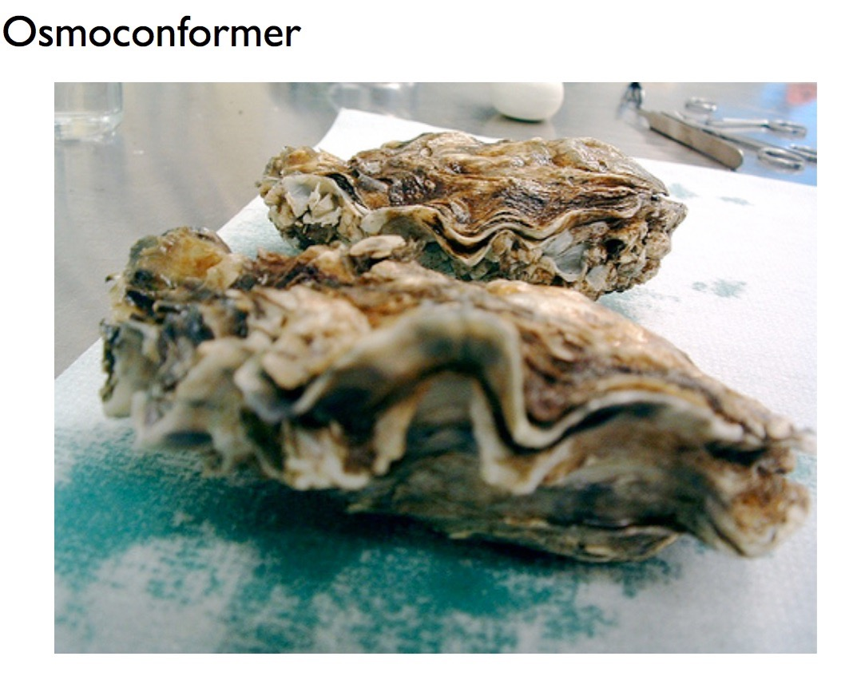

Slide 50
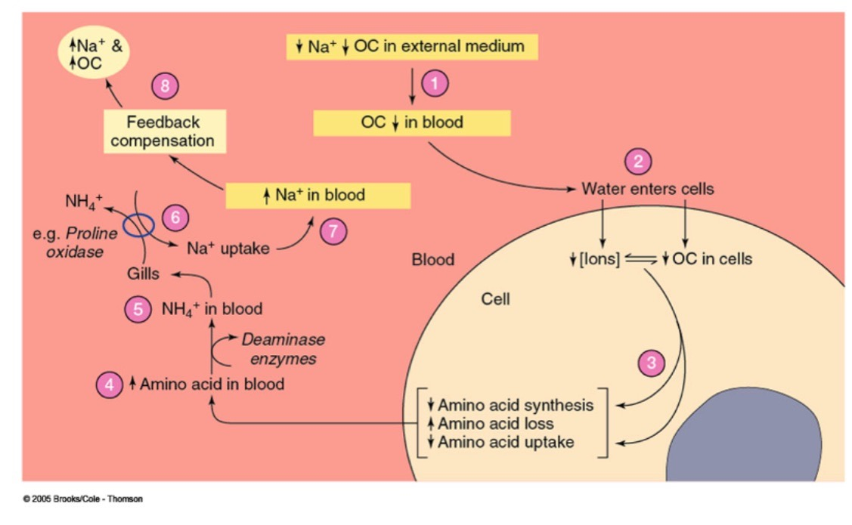
SW
more AA

Slide 52
Water and Electrolyte Balance in Freshwater Fish
Freshwater fish lose electrolytes across their gill epithelium by diffusion across a concentration gradient
To maintain homeostasis, they have to actively transport ions back into the body across the gill epithelium

Slide 53
Salmon and Sea Bass as Model Systems
Over the course of a lifetime, sea bass and several salmon species move between salt water and freshwater
Thus they move between environments with dramatically different osmotic stresses
The gill epithelia of marine fish have specialized cells called chloride cells, which are capable of moving salt
When sea bass and salmon are in salt water, these cells are abundant and active
In salt water, these cells secrete salt

Slide 54
Salmon and Sea Bass as Model Systems
Recent research suggests that there is a freshwater version of the chloride cell that imports salt
Evidence for the existence of this cell includes
Osmoregulatory cells may be in different locations, and different forms of Na⁺/K⁺-ATPase may be activated when fish are in the different types of water
When in salt water, the contransporter is on the basolateral side of the chloride cell
When in freshwater, the contransporter is on the apical side of the chloride cell
The orientation of key transport proteins “flips”

Slide 55
A Freshwater Chloride Cell?
When osmotic stress changes, the nature of the gill epithelium changes
Specifically, active pumping of ions takes place in a different population of cells in seawater versus freshwater
The salmon genome contains genes for several different forms of Na⁺/K⁺-ATPase
Different forms may be activated when individuals are in salt water versus freshwater

Slide 56
A Freshwater Chloride Cell?
Changing the position of the cotransporter may help fish deal with osmotic stress in both seawater and freshwater environments

Slide 57
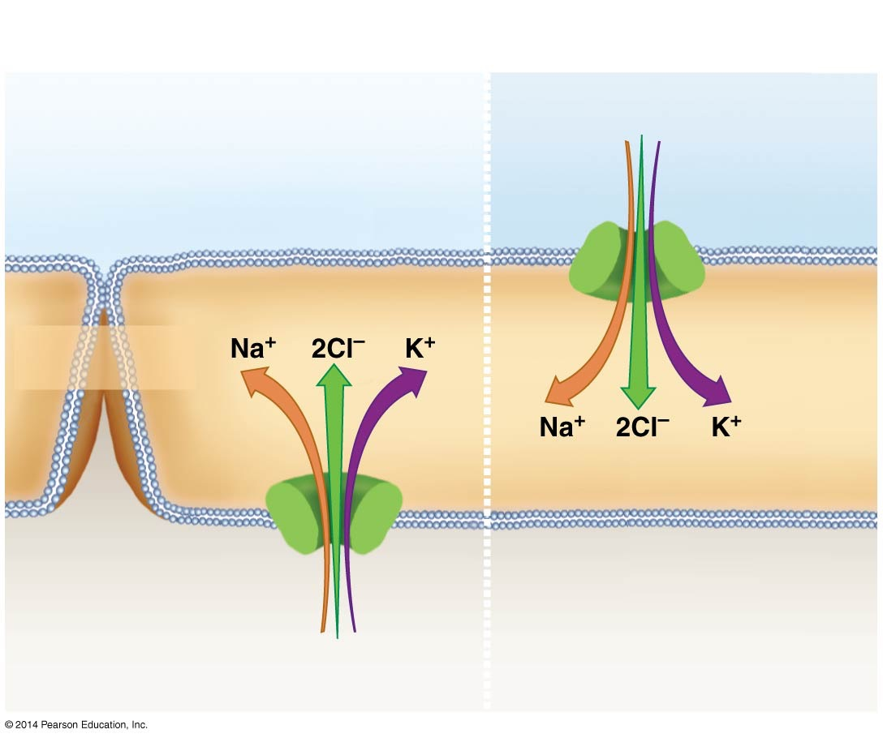
Figure 43.7
When sea bass is in seawater:
When sea bass is in freshwater:
Water flowing through gills
Na⁺/Cl⁻/K⁺ cotransporter in apical membrane
Epithelial cells of gill
Na⁺/Cl⁻/K⁺ cotransporter in basolateral membrane
Extracellular fluid, near blood vessels
Notes:
Figure 43.7 In the Epithelial Cells of Bass Gills, the Location of a Key Ion Cotransporter Can “Flip.”

Slide 58
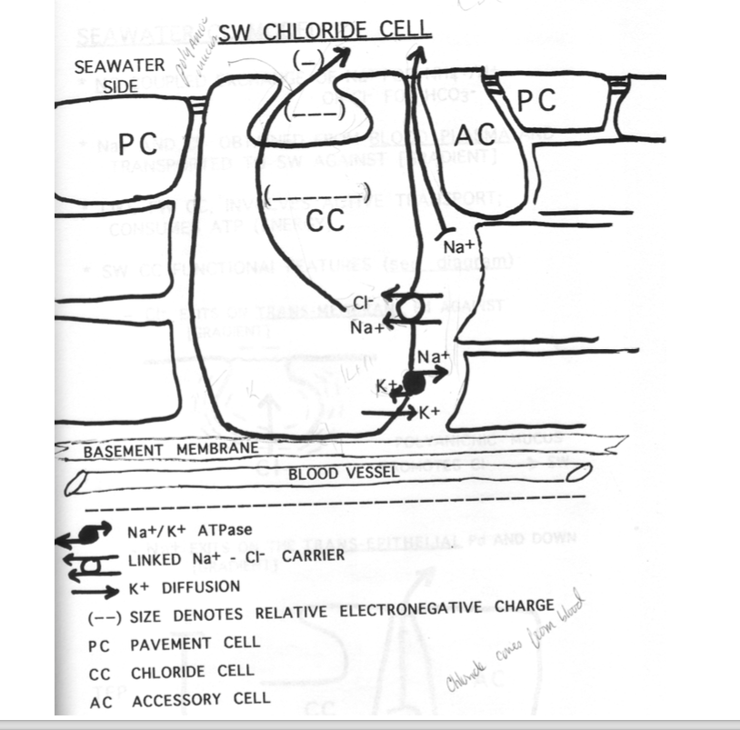

Slide 59
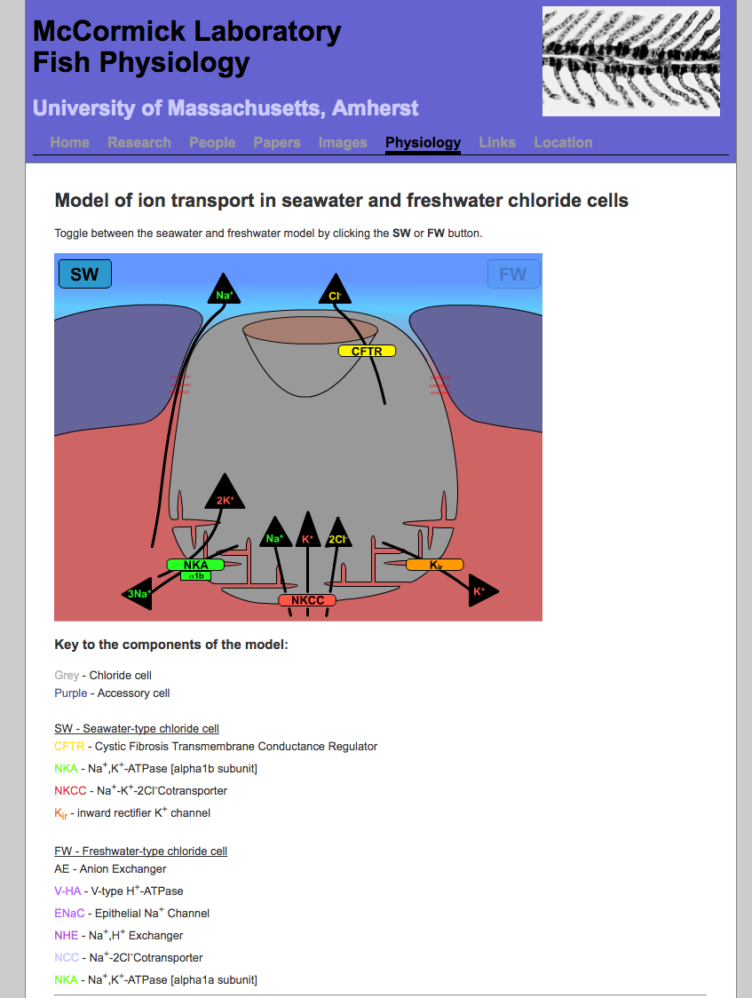

Slide 60
Water and Electrolyte Balance in Terrestrial Insects
By studying organisms that cope with severe osmotic stress, biologists gain insight as to how water and electrolyte balance is maintained
Two examples of this are the desert locust and flour beetle, which live in environments where osmotic stress is severe
These insects cope with their desert environment in two ways:
Minimizing water loss from their body surface
Carefully regulating the amount of water and electrolytes they excrete

Slide 61
Insects Minimize Water Loss from the Body Surface
Water loss is an inevitable by-product of respiration
Gas exchange in insects occurs across the membranes of epithelial cells lining the tracheae
An extensive system of tubes that functions as the insect’s respiratory organ
The tracheae connects with the atmosphere through openings called spiracles, which when open contribute to water loss
Muscles connected to the spiracles can close the spiracle during osmotic stress, preventing water loss

Slide 62
Insects Minimize Water Loss from the Body Surface
Spiracles can open or close as needed to minimize water loss
The ability to close spiracles is an important adaptation for minimizing water loss during respiration

Slide 63
Insects Minimize Water Loss from the Body Surface
Insects also minimize evaporation from their body surface. The exoskeleton consists of chitin, a tough polysaccharide, and layers of protein
The chitin and protein are collectively known as cuticle
The cuticle is covered with a layer of waterproof wax, an adaptation that minimizes evaporative water loss
The waxy cuticle is also hydrophobic, making it impermeable to water

Slide 64
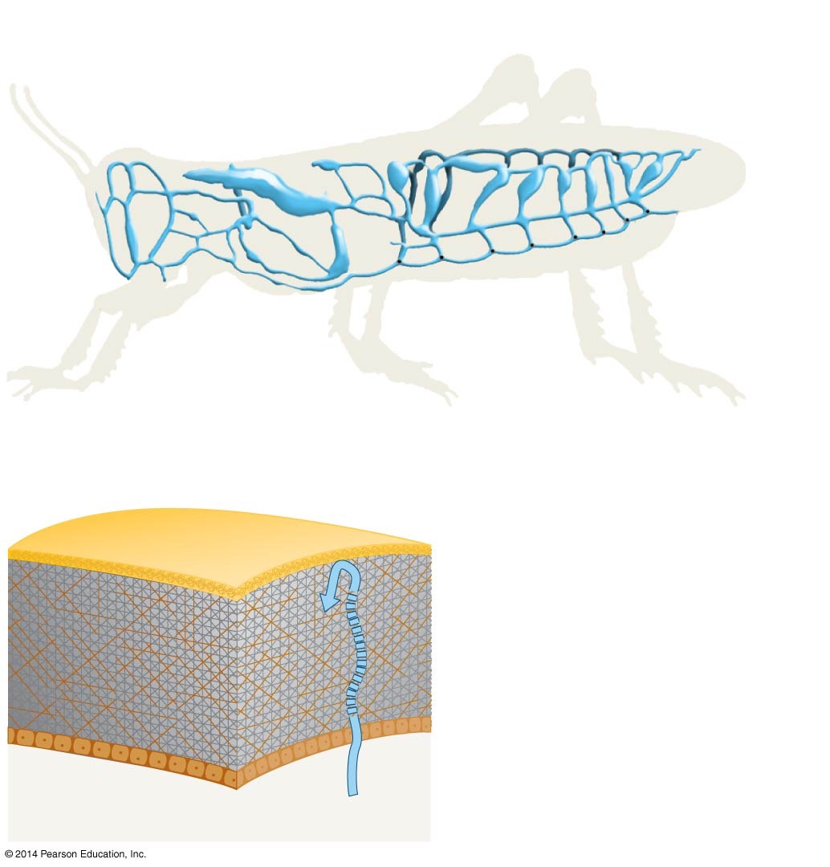
Figure 43.8
(a) Spiracles can be closed to minimize water loss from tracheae.
Tracheal system
Spiracles (openings)
(b) Except at spiracles, the insect body is covered with wax.
Wax layer
Cuticle (functions as exoskeleton)
Chitin + protein layer
Epidermis
Little water escapes
Notes:
Figure 43.8 In Desert Locusts, Adaptations Limit Water Loss during Respiration and from the Body Surface.

Slide 65
Maintaining Homeostasis: The Excretory System
To maintain homeostasis, insects must carefully regulate the composition of a bloodlike fluid called hemolymph
It is important for insects to regulate hemolymph composition because
Nitrogenous wastes have to be removed before they build up to toxic concentrations
Excess electrolytes must be excreted before they lead to osmotic stress
Water balance must be regulated constantly

Slide 66
The Excretory System of Insects
Through the excretory system, insects can avoid osmotic stress
To maintain water and electrolyte balance, insects have Malpighian tubules, an excretory organ, and the hindgut—the posterior portion of their digestive tract

Slide 67
Filtrate Forms in the Malpighian Tubules
Malpighian tubules
Have a large surface area
Are in direct contact with the hemolymph
Empty into the hindgut

Slide 68
Filtrate Forms in the Malpighian Tubules
Research suggests that epithelial cells in the Malpighian tubules are relatively impermeable to sodium ions but contain a pump that actively transports potassium ions into the tubules
The Malpighian tubules form a filtrate from the hemolymph
The filtrate is then passed on to the hindgut as a “pre-urine”
Pre-urine is modified excretion

Slide 69
The Potassium Pump of the Malpighian Tubules
Cells of the Malpighian tubules contain a potassium pump
This results in a high concentration of K⁺ in the cells
Water then follows by osmosis
Other electrolytes and nitrogenous wastes diffuse into the filtrate

Slide 70
Selective Reabsorption of Electrolytes and Water
If an insect is osmotically stressed due to a shortage of electrolytes and water
Electrolytes and water from the filtrate are reabsorbed in the hindgut and returned to the hemolymph
Forming a hypertonic urine and resulting in water conservation and nitrogenous waste elimination
The epithelial cells in the hindgut transport ions out of the pre-urine and into the hemolymph
Water then follows by osmosis, creating a concentrated urine

Slide 71
Selective Reabsorption of Electrolytes and Water
Research indicates that insects’ hindguts have two active pumps
A chloride pump and Na⁺/K⁺-ATPase, which is responsible for pumping ions out of the lumen and into the hemolymph
Cl– is pumped into cells from the hindgut lumen
K⁺ follows through potassium channels along an electrochemical gradient, and water follows via osmosis
In the basolateral membrane, Na⁺/K⁺-ATPase sets up gradients that favor movement of Cl–, K⁺, and H₂O into the hemolymph

Slide 72
How the Ions Move
There are three steps to moving the ions
H⁺ is pumped into the hindgut lumen, this favors the movement of K⁺ and water into the cells
Contraporters move the H⁺/Cl– into the cells
The gradient favors Na⁺ moving into the epithial cell and the diffusion of Cl– and K⁺ into the hemolymph

Slide 73
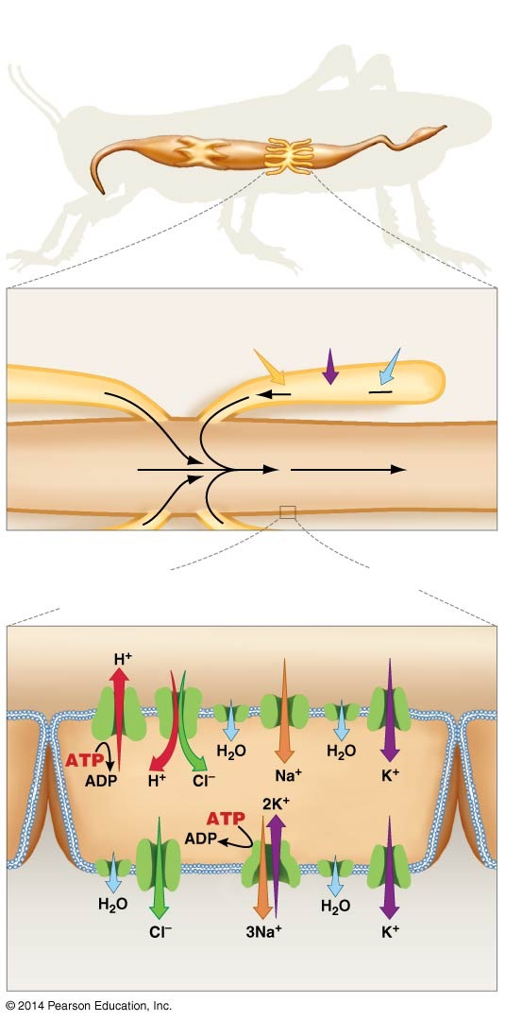
Figure 43.9
(a) Malpighian tubules produce an isosmotic pre-urine.
Midgut
Malpighian tubules
Hindgut
From hemolymph
Malpighian tubules
Nitrogenous waste
Electrolytes
Water
Pre-urine
Pre-urine
Digested food
Final urine and feces
Midgut
Hindgut
(b) Under osmotic stress, the hindgut reabsorbs electrolytes and water to form a hyperosmotic urine.
Lumen of hindgut
H⁺/Cl⁻ cotransporter
Sodium channel
Potassium channel
Apical membrane
Basolateral membrane
Aquaporin
Chloride channel
Na⁺/K⁺- ATPase
Hemolymph
Notes:
Figure 43.9 In Insects, Urine Forms in the Malpighian Tubules and Hindgut.

Slide 74
An Overview of Water Regulation and Electrolyte Balance
Several general principles have emerged from insect studies:
Water is not pumped directly—it moves only by osmosis via osmotic gradients set up by active transport of ions
The formation of the filtrate is not particularly selective
Unlike filtrate formation, reabsorption is highly selective for certain molecules and ions
Any remaining waste products are then eliminated with the feces
In contrast to filtrate formation, reabsorption is also tightly regulated in response to osmotic stress

Slide 75
Water and Electrolyte Balance in Terrestrial Vertebrates
Terrestrial vertebrates must carefully regulate the osmolarity of their tissues
To replace the water they lose, most terrestrial vertebrates drink
They also ingest electrolytes in food
In land-dwelling vertebrates, osmoregulation occurs primarily through events that take place in the kidney
The kidney is responsible for water and electrolyte balance as well as the excretion of nitrogenous wastes

Slide 76
The Structure of the Mammalian Kidney
Kidneys occur in pairs and are located in the back side of the body
The renal artery brings blood containing nitrogenous wastes into the kidney; the renal vein carries the cleaned blood away
The urine formed in the kidney is transported via a long tube called the ureter to a storage organ called the bladder
From the bladder, urine is transported to the body surface via a tube called the urethra and is then excreted

Slide 77
The Structure of the Kidney
Most of the kidney’s mass is made up of small structures called nephrons
The nephron is the basic unit of function of the kidney
The nephron is responsible for the water and electrolyte balance
Most of the nephrons are located in the outer region of the kidney called the cortex; the inner region is the medulla

Slide 78
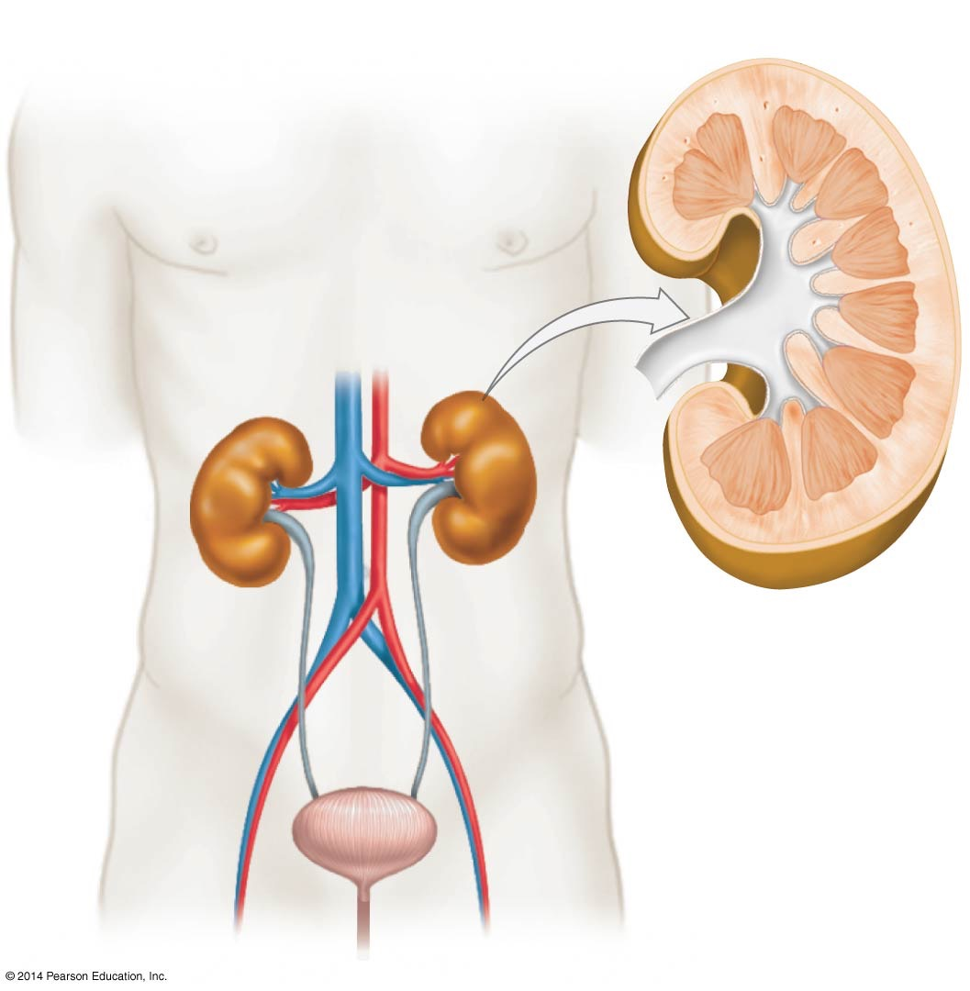
Figure 43.10
(a) Urinary system
(b) Kidney
Cortex
Medulla
Kidney
Renal vein
Renal artery
Ureter
Bladder
Urethra
Notes:
Figure 43.10 Anatomy of the Human Urinary System and Kidney.

Slide 79
The Function of the Nephron
The nephron shares important functional characteristics with the insect excretory system
Water cannot be transported actively—it moves only by osmosis
To move water, cells in the kidney set up strong osmotic gradients
By regulating these gradients and specific channel proteins, kidney cells exert precise control over loss or retention of water and electrolytes

Slide 80
The Four Major Regions of the Nephron
Nephrons have four major regions and are closely associated with a collecting duct
The renal corpuscle filters blood, forming a “pre-urine” consisting of ions, nutrients, wastes, and water
In the proximal tubule, epithelial cells reabsorb nutrients, vitamins, valuable ions, and water
The loop of Henle establishes a strong osmotic gradient in the tissues outside the loop, and osmolarity increases as the loop descends
In the distal tubule, ions and water are reabsorbed

Slide 81
Video

Slide 82
The Function of the Kidney: An Overview
To maintain homeostasis with respect to water, more water may be reabsorbed in the collecting duct
In addition, urea leaves the base of the collecting duct and contributes to the osmotic gradient set up by the loop of Henle
The blood vessels that are juxtaposed with the nephron play a key role
They bring “dirty” blood into the nephron and then take away the molecules and ions that are reabsorbed from the initial filtrate

Slide 83
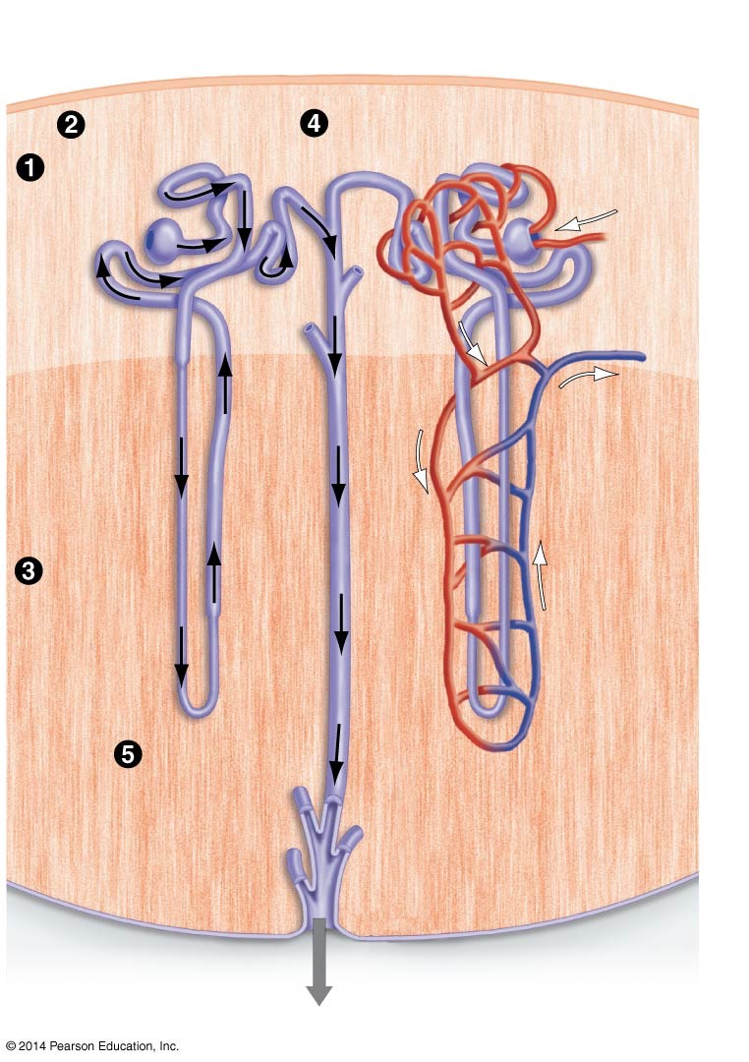
Figure 43.11
(a) The structure of the nephron and collecting duct
(b) Blood vessels serve each nephron.
Proximal tubule
Distal tubule
Renal corpuscle
Blood enters
Cortex
Blood leaves
Loop of Henle
Medulla
Collecting duct
Vasa recta
Final urine to ureter
Notes:
Figure 43.11 A Nephron Has Four Major Parts, Empties into a Collecting Duct, and Is Served by Blood Vessels.

Slide 84
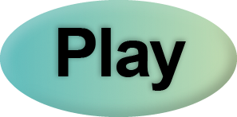
Kidney Anatomy
BLAST Animation: Kidney Anatomy

Slide 85
Filtration: The Renal Corpuscle
Urine formation begins in the renal corpuscle, which is made up of the glomerulus and the Bowman’s capsule
The glomerulus is a cluster of capillaries that bring blood to the nephron from the renal artery
The Bowman’s capsule is the region of the nephron that surrounds the glomerulus
The renal corpuscle functions as a filtration device

Slide 86
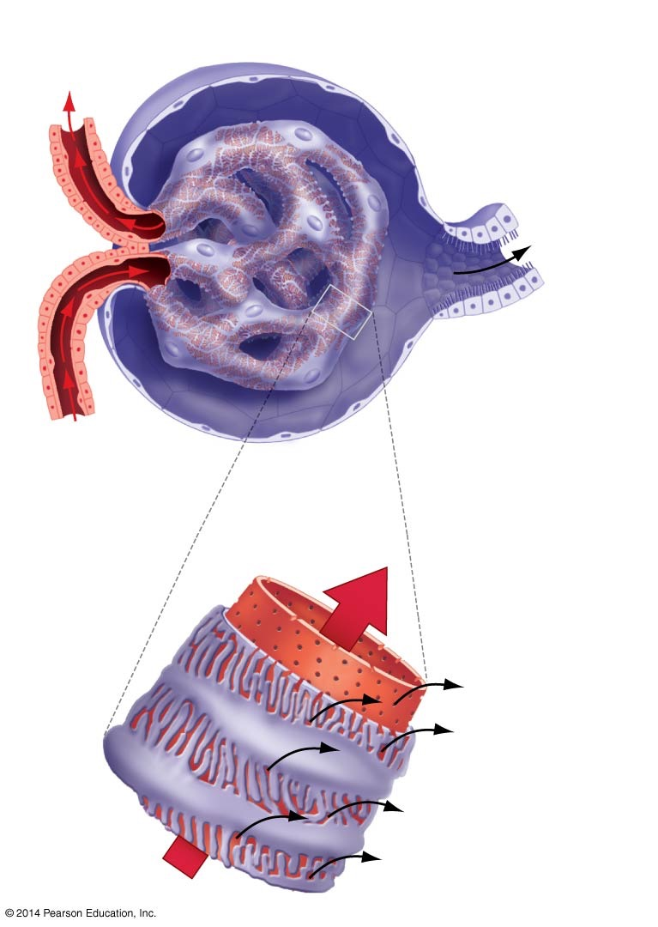
Figure 43.12
(a) Anatomy of the renal corpuscle
Blood leaves glomerulus.
Bowman’s capsule
Glomerulus
Pre-urine leaves Bowman’s capsule.
Blood enters glomerulus.
(b) Filtration
Pores in glomerulus
Large molecules and cells remain in bloodstream.
Filtration slits in cells that wrap around vessel
Fluid and small solutes are pushed through the pores and the filtration slits into Bowman’s capsule.
Direction of blood movement
Notes:
Figure 43.12 Urine Formation Begins When Blood Is Filtered in the Renal Corpuscle.

Slide 87
Filtration: The Renal Corpuscle
The renal corpuscle is surrounded by blood capillaries
The capillaries have large pores surrounded by cells that are folded into slits and ridges
Water and solutes are forced out of the blood through the pores in the glomerulus
Resulting in the formation of a filtrate that allows water and small solutes into the Bowman’s capsule

Slide 88
Filtration: The Renal Corpuscle
Larger molecules remain in the blood and cannot enter the nephron
Pressure required for this movement of smaller molecules is supplied from the blood
About 25% of the water and solutes present in blood is removed

Slide 89
Filtration: The Renal Corpuscle
The renal corpuscles of a human kidney are capable of producing about 180 liters of filtrate per day
About 99% of the filtrate is recycled—only a tiny fraction of the original volume is actually excreted
Filtering large volumes from the blood allows wastes to be removed effectively
Pairing this process with reabsorption allows waste excretion to occur with a minimum of water and nutrient loss

Slide 90
Reabsorption: The Proximal Tubule
Filtrate containing water, waste products, and valuable nutrients leaves Bowman’s capsule and enters a convoluted structure called the proximal tubule
The fluid inside this tubule contains water and small solutes such as urea, glucose, amino acids, vitamins, and electrolytes
Some of these molecules are waste products; others are valuable nutrients

Slide 91
Active Transport Occurs in Epithelial Cells
The epithelial cells of the proximal tubule have a prominent series of small projections called microvilli facing the lumen
The microvilli greatly increase the epithelial surface area
The proximal tubule functions in active transport of selected molecules out of the filtrate
Solutes leave the proximal tubule and enter epithelial cells; water follows along the osmotic gradient
In this way, valuable solutes and water are reabsorbed and returned to the body

Slide 92
The “Master Gradient”
Selective reabsorption requires four molecular mechanisms resulting in a “master gradient”
Na⁺/K⁺-ATPase in the basolateral membranes removes intracellular Na⁺
Creating a gradient for Na⁺ entry from the lumen
In the apical membrane, Na⁺-dependent cotransporters use the gradient to remove valuable ions and nutrients selectively from the filtrate
The movement of Na⁺ into the cell sets up the means for moving other solutes against the concentration gradient

Slide 93
The “Master Gradient”
The solutes that move into the cell diffuse across the basolateral membrane into nearby blood vessels
Water follows ions from the proximal tubule into the cell and then into the blood vessels
Almost all nutrients, NaCl, and water are reabsorbed through the proximal tubule

Slide 94
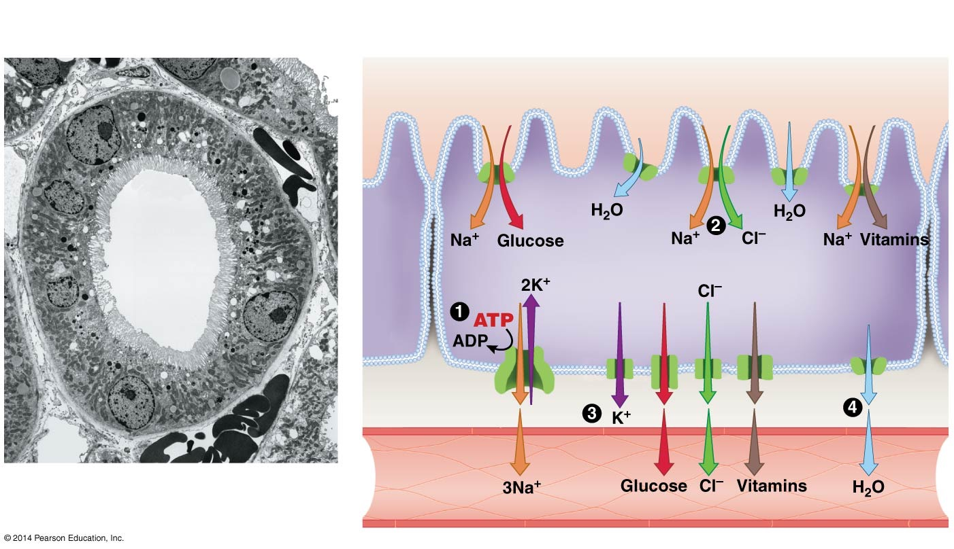

Figure 43.13
(a) Microvilli expand surface area of lumen of proximal tubule.
(b) Model of selective reabsorption in proximal tubules
Lumen of proximal tubule
Apical membrane
Aquaporin
Lumen
Microvilli
Basolateral membrane
2 μm
Blood vessel near proximal tubule
Notes:
Figure 43.13 Water, Electrolytes, and Nutrients Are Reabsorbed in the Proximal Tubule.

Slide 95
The Loop of Henle
In about 20% of human nephrons, the fluid from the proximal tubule enters the loop of Henle
The loop of Henle is part of the proximal tubule that penetrates deep into the medulla

Slide 96
Creating an Osmotic Gradient: The Loop of Henle
In 1942, Werner Kuhn hypothesized that the loop of Henle functions as a countercurrent exchanger and multiplier that sets up an osmotic gradient rather than exchanging heat
The countercurrent flow of fluids sets up an osmotic gradient instead of a heat exchange
Kuhn proposed, and experiments confirmed, that
The osmolarity of the fluid inside the loop of Henle is low in the cortex and high in the medulla
The osmolarity in tissues surrounding the loop mirrors the gradient inside the loop

Slide 97
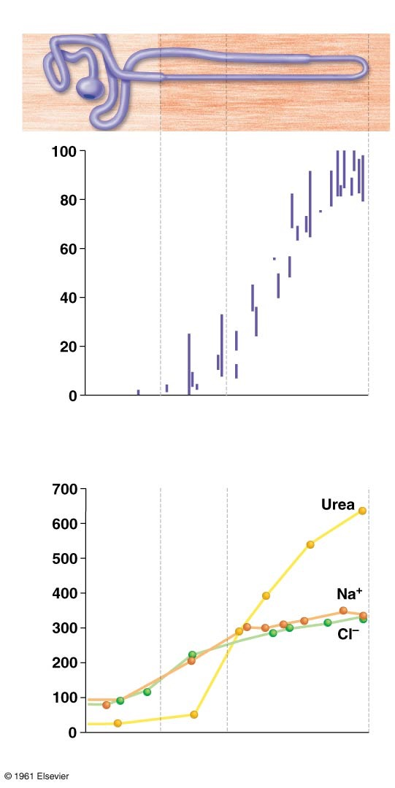
Figure 43.14
(a) Fluid inside the loop of Henle
Loop of Henle
Percentage of maximum osmolarity
A strong gradient in osmolarity exists inside the loop
Cortex
Outer medulla
Inner medulla
(b) Interstitial fluid outside the loop of Henle
Concentration (mmol/L)
A strong gradient in osmolarity exists outside the loop
Cortex
Outer medulla
Inner medulla
Notes:
Figure 43.14 Data Confirm the Existence of a Strong Osmotic Gradient Both Inside and Outside the Loop of Henle.
© 1961 Elsevier http://www.journals.elsevier.com/progress-in-cardiovascular-diseases

Slide 98
Structure of the Loop of Henle
The loop of Henle has three distinct regions:
The descending limb
A thin ascending limb
A thick ascending limb
The loop of Henle maintains an osmotic gradient because water leaves the descending limb and salt leaves the ascending limb

Slide 99
The Osmotic Gradient of the Loop of Henle
The descending limb is highly permeable to water but almost completely impermeable to solutes
The ascending limb is highly permeable to Na⁺ and Cl–, moderately permeable to urea, and almost completely impermeable to water
Urea collects in the distal part of the tubule

Slide 100
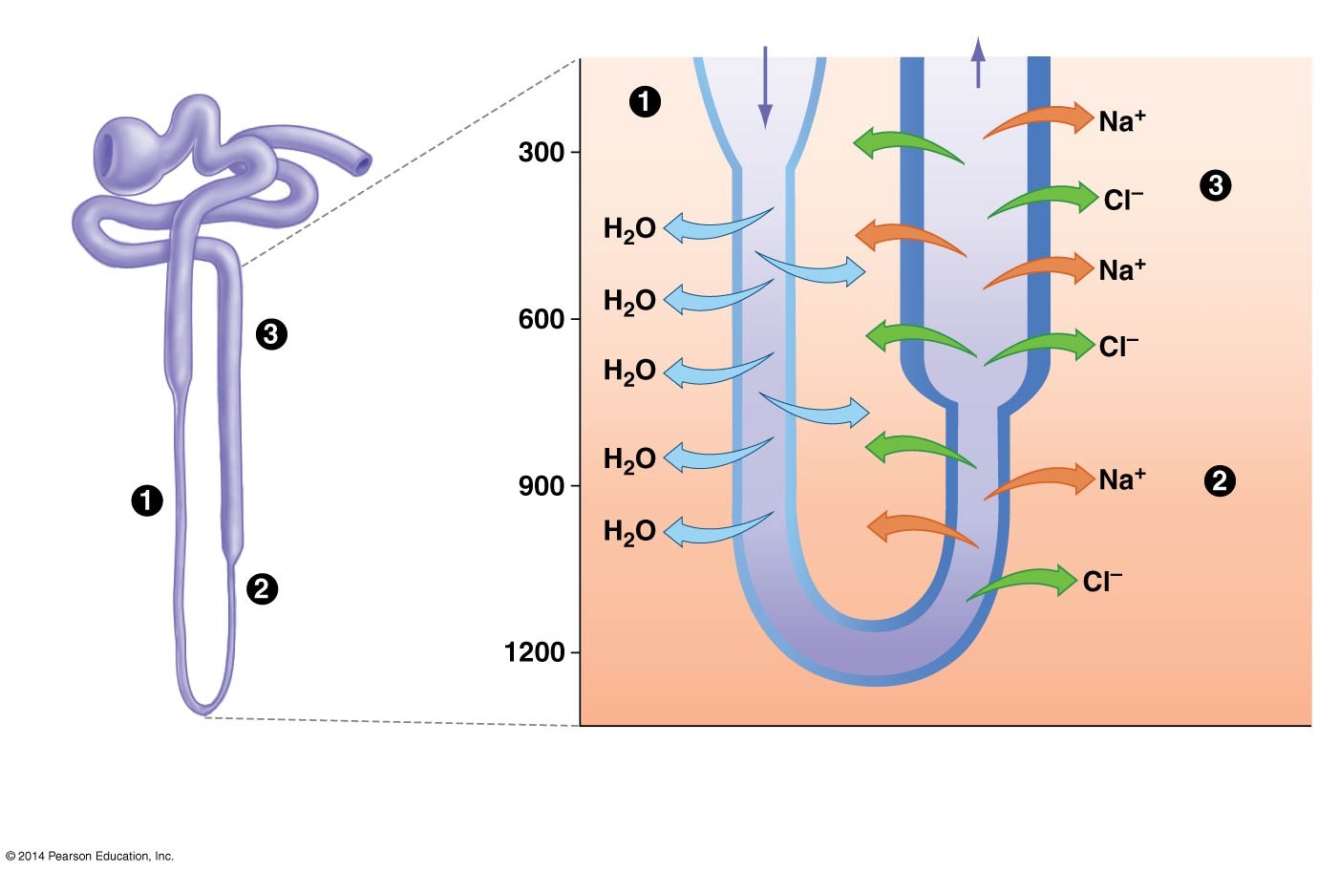
Figure 43.15
(a) Three regions in the loop of Henle
(b) Water and ion movement differ in the three regions.
100
Passive transport
300
300
Active transport
Osmolarity of fluid inside loop of Henle (milliosmol/L)
600
Thick ascending limb
600
900
Passive transport
Descending limb
Thin ascending limb
1200
Descending limb is highly permeable to water but impermeable to solutes
Ascending limb is nearly impermeable to water but highly permeable to Na⁺ and Cl–
Notes:
Figure 43.15 The Loop of Henle Maintains an Osmotic Gradient because Water Leaves the Descending Limb and Salt Leaves the Ascending Limb.

Slide 101
A Comprehensive View of the Loop of Henle
As fluid flows down the descending limb, the fluid inside the loop loses water to the tissue surrounding the nephron
This movement of water is passive, down its osmotic gradient
At the bottom of the loop, the fluids inside and outside the nephron have high osmolarity
The filtrate does not continue to lose water, because the membrane is nearly impermeable to water

Slide 102
A Comprehensive View of the Loop of Henle
The fluid inside the nephron begins to lose Na⁺ and Cl– in the thin ascending limb
These ions move out of the loop passively along their concentration gradients

Slide 103
Maintaining the Osmotic Gradient
In the thick ascending limb, where the osmolarity of the surrounding solution is low, additional Na⁺ and Cl– ions are actively transported out of the nephron
The countercurrent flow of material is self reinforcing—the presence of an osmotic gradient stimulates water and ion flows that in turn maintain the osmotic gradient

Slide 104
How the Kidney Works
BLAST Animation: How the Kidney Works

Slide 105
The Role of the Vasa Recta
The water and salt that move out of the loop quickly diffuse into the vasa recta
The vasa recta is the associated network of blood vessels found at the bottom of the nephron
Water and salt diffuse from the loop and into the vasa recta
As a result, water and electrolytes are returned to the body

Slide 106
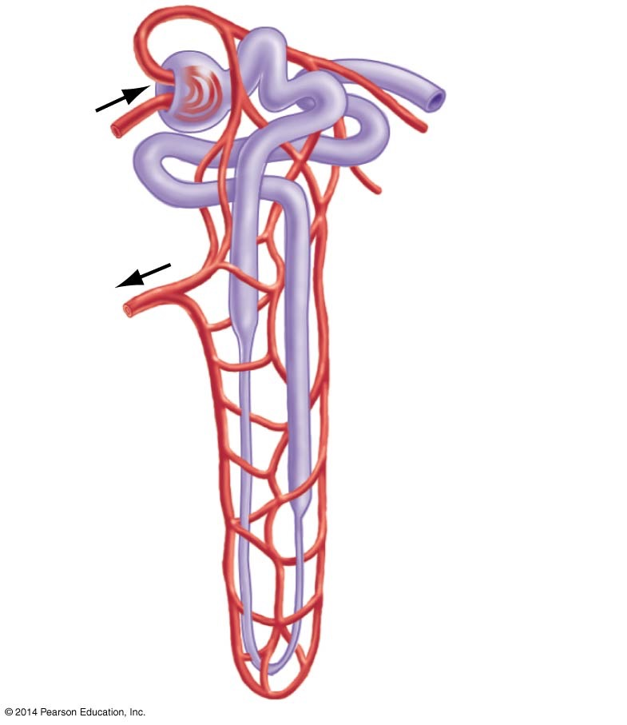
Figure 43.16
Blood enters
Blood leaves
Blood vessels called the vasa recta run along the loop of Henle
Notes:
Figure 43.16 Blood Supply to the Loop of Henle.

Slide 107
The Collecting Duct Leaks Urea
The osmotic gradient is established in part by the nephron’s final portion—the collecting duct
Urea diffuses out of the innermost section of the collecting duct, creating the steep osmotic gradient of the space surrounding the nephron—high in the inner medulla and low in the outer medulla

Slide 108
Regulating Water and Electrolyte Balance
Once filtrate has passed through the loop of Henle, it enters the distal tubule
This fluid is slightly hypotonic to blood, and the solutes it contains are mainly urea and other waste products
The distal tubule lies between the proximal tubule and the blood vessels that surround the major portion of the nephron
The distal tubule empties urea into the ureter

Slide 109
Regulating Water and Electrolyte Balance
The fluid that enters the distal tubule is relatively constant in composition over time
In contrast, the urine that leaves the collecting duct is highly variable in osmolarity and in Na⁺ and Cl– concentration

Slide 110
Urine Formation Is under Hormonal Control
The activity of the distal tubule and collecting duct is highly regulated and altered in response to osmotic stress
The amount of Na⁺, Cl–, and water that is reabsorbed in the distal tubule and in the collecting duct varies with the animal’s condition
Changes in the distal tubule and collecting duct are controlled by hormones

Slide 111
Urine Formation Is under Hormonal Control
If Na⁺ levels in the blood are low, the adrenal glands release the hormone aldosterone, which leads to activation of sodium pumps and reabsorption of Na in the distal tubule
Aldosterone saves sodium
If an individual is dehydrated, the brain releases antidiuretic hormone (ADH, also referred to as vasopressin or arginine vasopressin)
ADH saves water

Slide 112
How Does ADH Work?
ADH has two important effects on epithelial cells in the collecting duct:
ADH triggers the insertion of aquaporins into the apical membrane
As a result, cells become much more permeable to water and large amounts of water are reabsorbed
ADH increases permeability to urea, which increases the osmolarity of the surrounding fluid and thus water loss from the filtrate

Slide 113
How Does ADH Work?
Water leaves the collecting duct passively—following the concentration gradient maintained by the loop of Henle
When ADH is present, water is conserved and urine is strongly hypertonic relative to blood
When ADH is absent, few aquaporins are found in the collecting duct epithelium, leaving it relatively impermeable to water and resulting in hypotonic urine

Slide 114
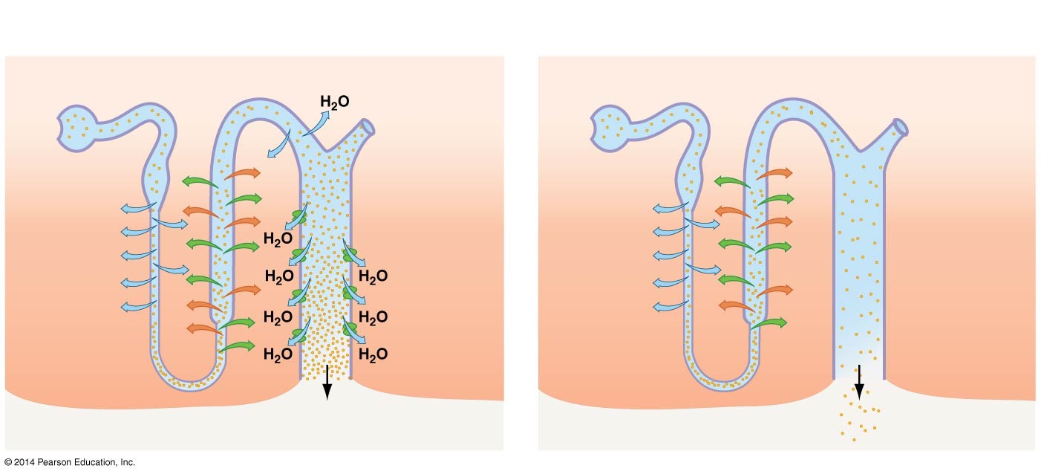
Figure 43.17
(a) ADH present: Collecting duct is highly permeable to water.
(b) No ADH present: Collecting duct is not permeable to water.
Distal tubule
Cortex
Distal tubule
Cortex
Loop of Henle
Collecting duct
Loop of Henle
Collecting duct
Aquaporins
Solutes
Medulla
Solutes
Medulla
Small volume of concentrated urine
Large volume of dilute urine
Notes:
Figure 43.17 ADH Regulates Water Reabsorption by the Collecting Duct.

Slide 115
The Mammalian Kidney
Web Activity: The Mammalian Kidney

Slide 116
Summary
The first three segments of the nephron—the renal corpuscle, proximal tubule, and loop of Henle—concentrate nitrogenous wastes, and create the possibility for Na⁺, Cl–, and water to be either excreted or reabsorbed by the distal tubule and collecting duct
The nephron is a remarkably effective mechanism for regulating water and electrolyte balance and achieving homeostasis

Slide 117
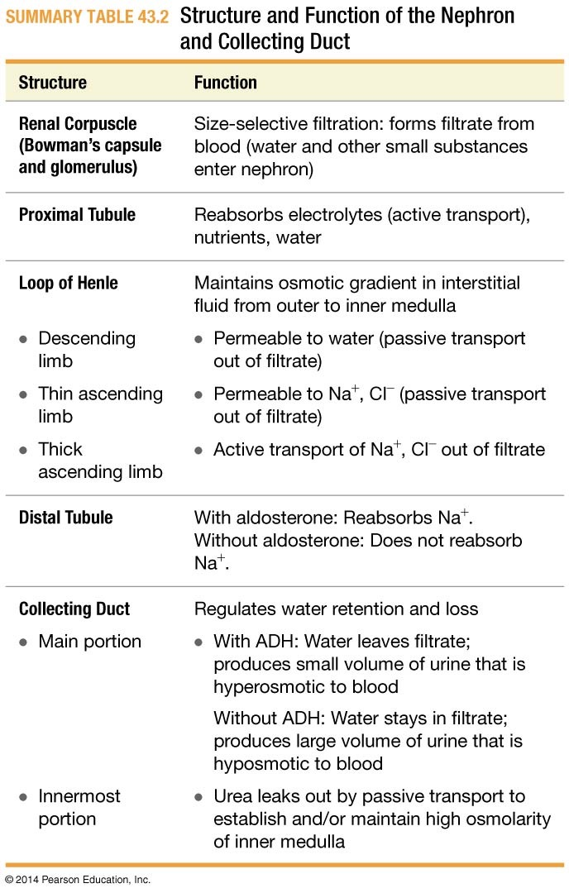
Table 43.2
Notes:
SUMMARY TABLE 43.2 Structure and Function of the Nephron and Collecting Duct

